Slide 1
Development of 3D Visualization and Volumetry Analysis for Liver Tumour Diagnosis Using Artificial Intelligence

Slide 2
Modules and Timelines
Modules | Work | Persons Responsible | Timeline
I | Hypothesis Testing – Qualitative | Dr.Biju, Dr.B.Lakshmipriya | Completed
II | Hypothesis Testing – Quantitative | Dr.Biju, Dr.B.Lakshmipriya, Dr.Jayanthi | 1 Month
III | Tumour Aggressiveness Quantification through Open Source Software | Dr.Biju, Dr.B.Lakshmipriya | 2 Months
IV | 3D Reconstruction and Volume Calculation | Dr.Jayanthi, Dr.B.Lakshmipriya and PEC students | 2 Months
V | Integration as a Single Application | Dr.Jayanthi and PEC students | 1 Month

Slide 3
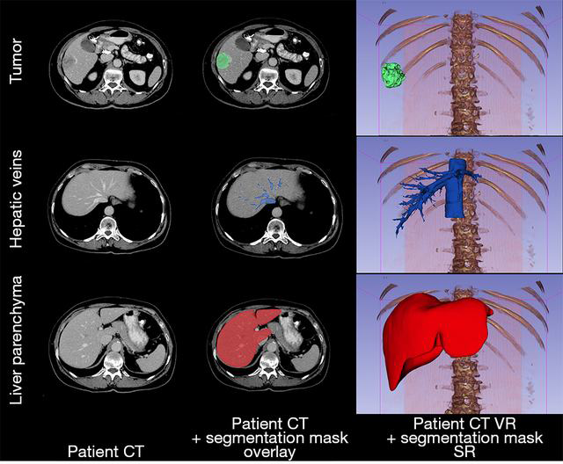
3D model creation

Slide 4
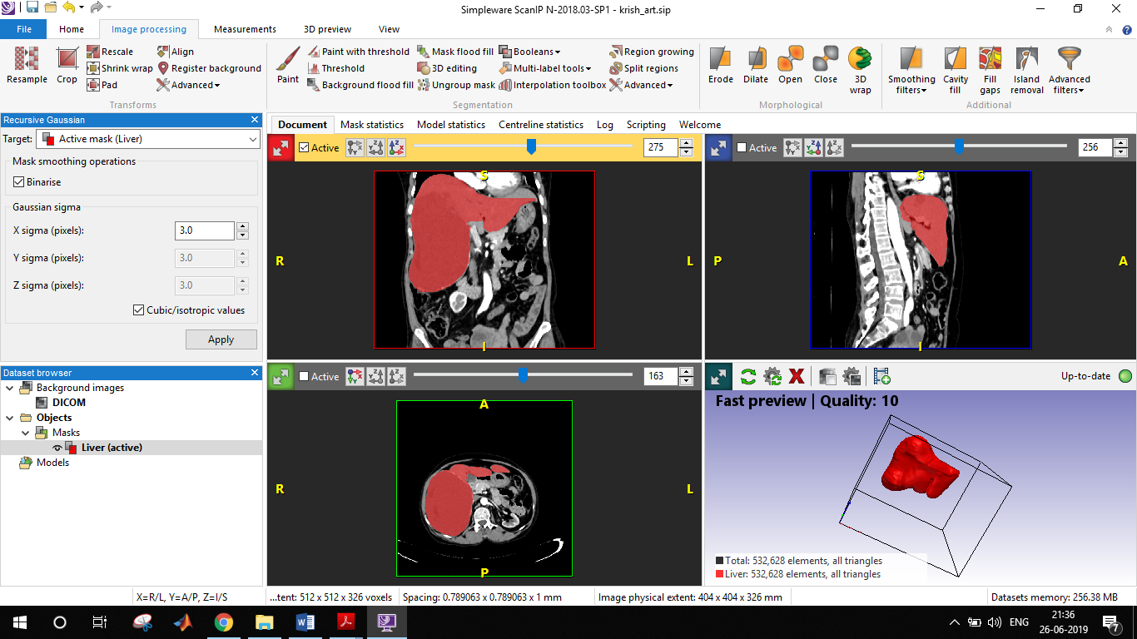
Simpleware ScanIP at PEC

Slide 5
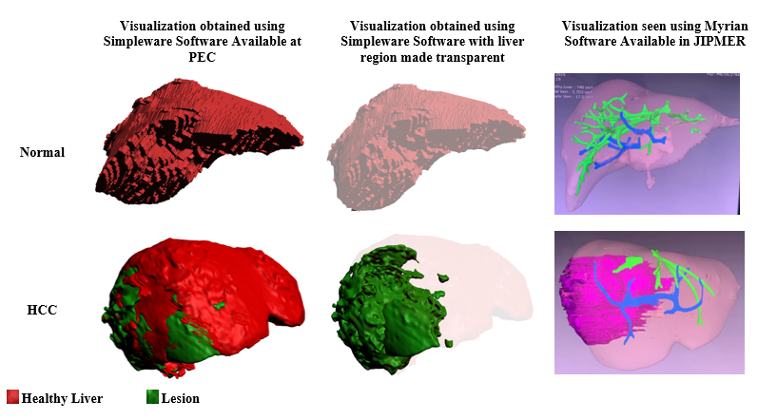

Slide 6
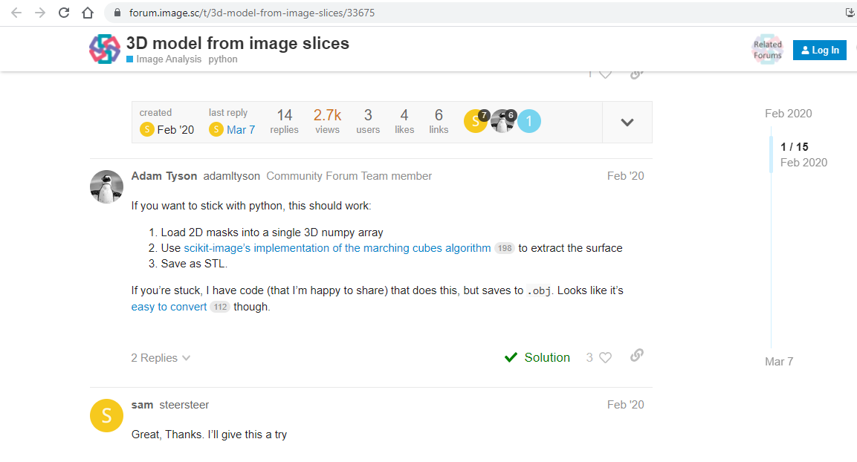

Slide 7
3D Volumetry Softwares – open access
ITKsnap, http://www.itksnap.org
3D Slicer, http://www.slicer.org/
ImageJ, http://imagej.nih.gov/ij/
MeVisLab, http://www.mevislab.de/

